Slide 1
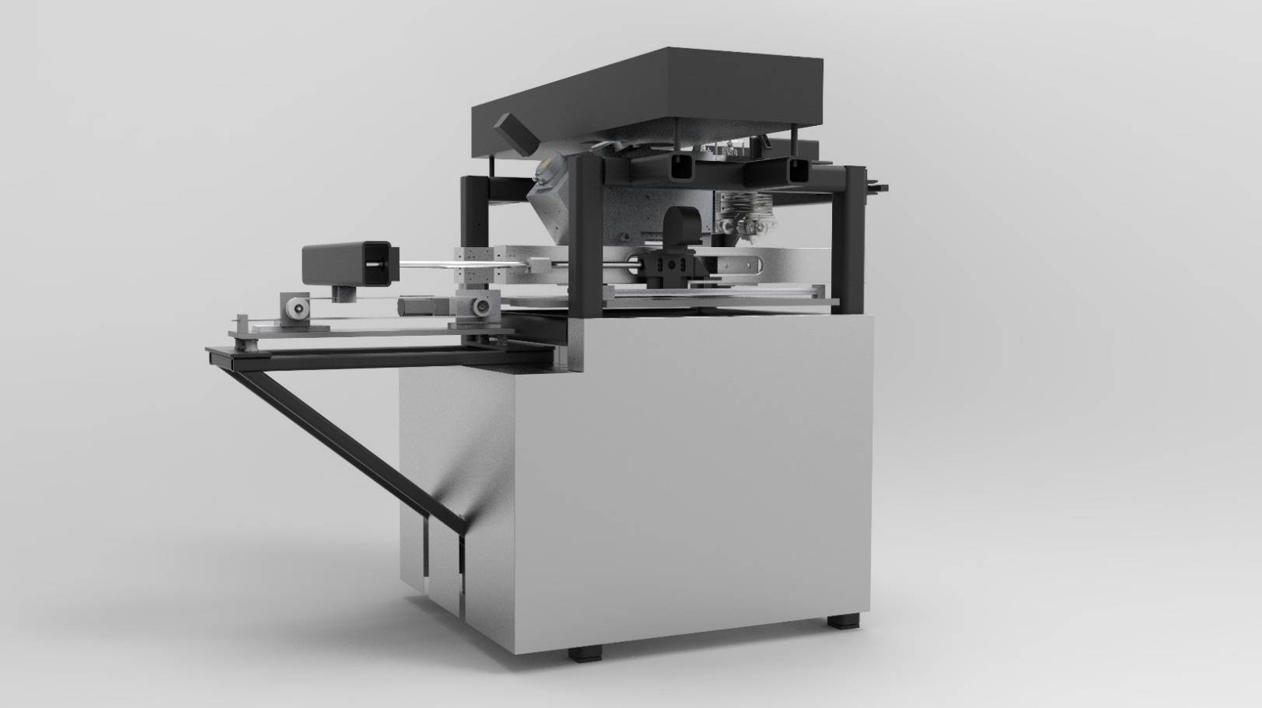
Data Analysis with LAMPS
Description of Data Input and Output during SLS build process

Slide 2
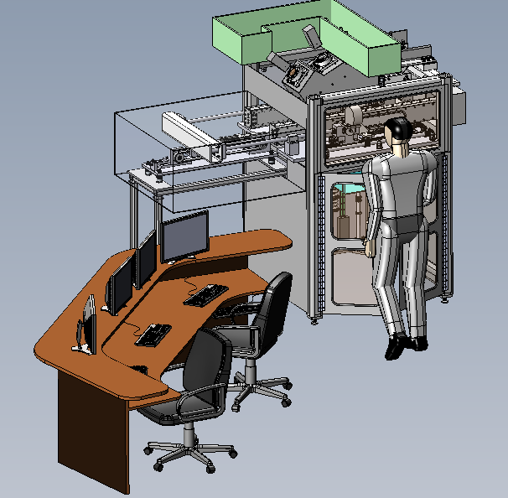
Introduction LAMPS
General Information
Laser Additive Manufacturing Pilot System (LAMPS)
SLS testbed designed and built at UT Austin for process control research
Open Architecture Software allowing access to all process parameters
Enable examination of polymers up to PEEK/PAEK/PEKK class: (Process temps as high as 350 C)
Provide In-situ measurement access

Slide 3
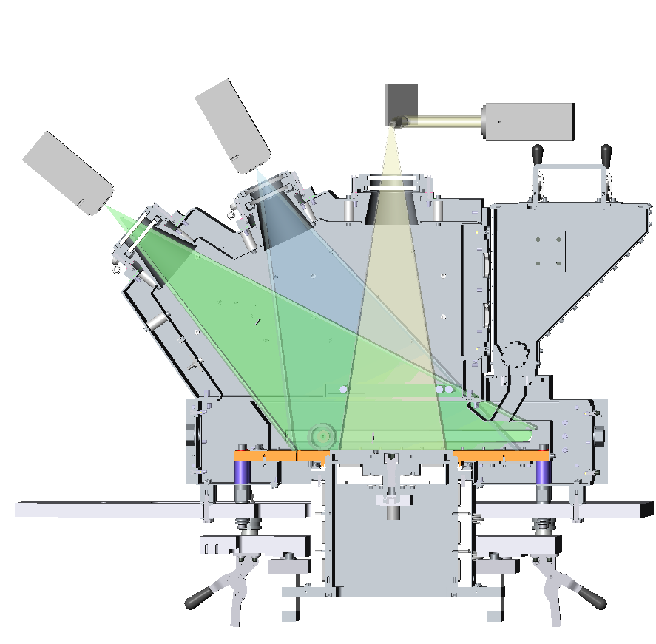
Introduction LAMPS
Sensors and Actuators implemented in LAMPS
Sensors
2 x MWIR Cameras
1 x Visual Camera
> 50 Thermocouples
1 x Optical Coherence Tomography (OCT) System
Actuators
1 x Laser with 2 axis Galvometers
3 x Quartz Lamps
> 10 Strip Heaters
Piston height adjustment (layer thickness)
Powder spreading roller (translation and rotation independent control)
Nitrogen flow rate (manual valve control, can be other gas) and pre-heating
1, 4
2
5
1
6
9
3
7

Slide 4
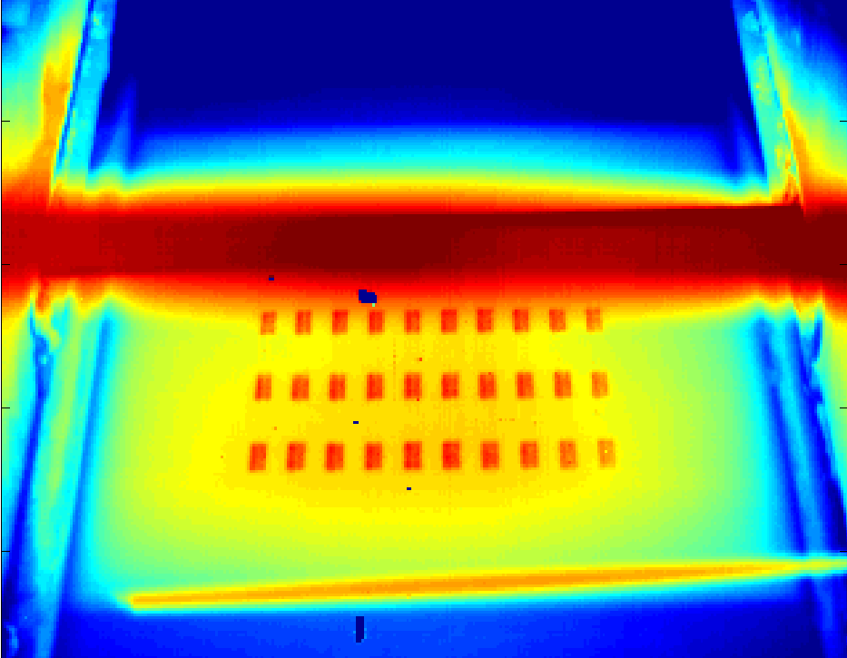
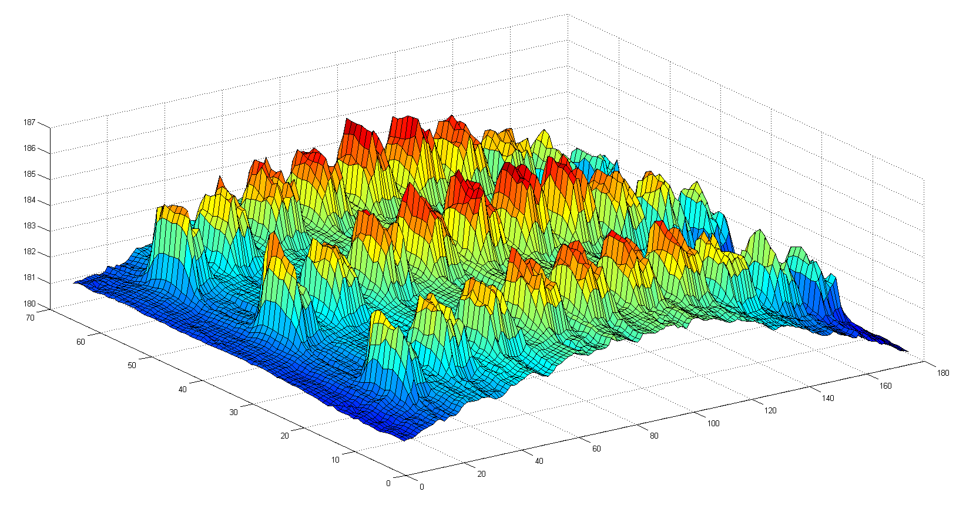
Sensors and Actuators
Data produced by Sensors – Powderbed IR camera & Thermocouples
6701 MWIR (30 – 60 Hz currently used framerate)
Up to 126 Hz in full window mode (640 x 512 pixels)
Provides multiple Region of Interest (ROI) mean for
Drop zone
Build Surface (1 Hz)
ROI temperatures used to control quartz lamp powers
Provides real-time video for user monitoring
Thermocouples (1-2 Hz)
Locations
Chamber walls
Chamber atmosphere
Build box / piston walls and optional manual insertion into powder
6701 MWIR IR image

Slide 5
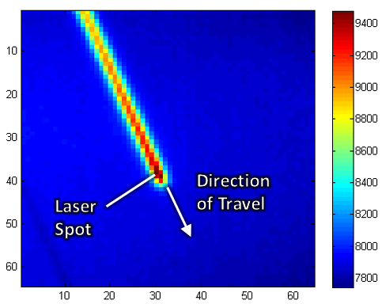
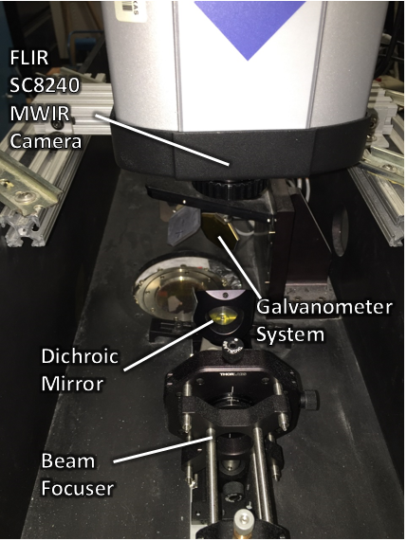
Sensors and Actuators
Data produced by Sensors – Boresighted & Visual Camera
FLIR SC8240 IR camera
Up to 2,243 Hz framerate at 64x64 pixels, area of pixel is roughly 300 x 340 microns
132 Hz frame rate for full window (pixels?)
Boresighted with CO₂ laser
Typically used in conjunction with laser action (prior to or during laser scans)
Visual camera
Takes 1 image before roller spread and 2 images after spread
Provides real-time video of the powder bed for user monitoring (user evaluation of powder spreading quality, or other surface/part movement anomalies)
FLIR SC8240 IR image

Slide 6
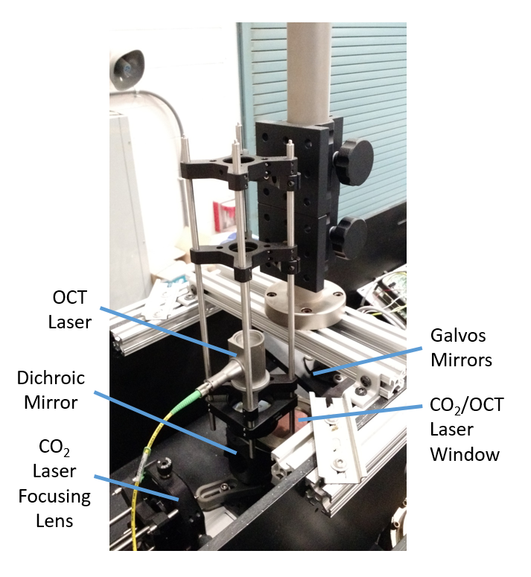
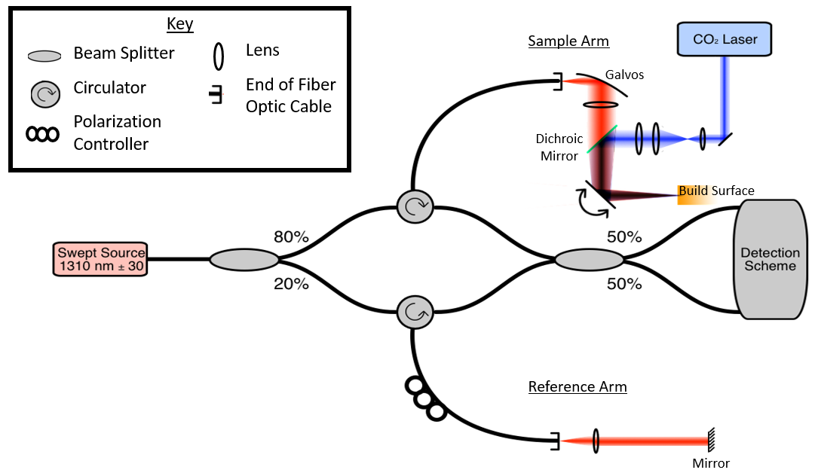
Sensors and Actuators
Data produced by Sensors - Optical coherence tomography (OCT)
OCT measurements (100 kHz sample rate)
Established non-invasive, high resolution medical imaging technique
Produces cross-sectional and 3D representations of sample
Data volume dependent on experimental requirements (do we have an idea what a typical B scan data volume is?)

Slide 7
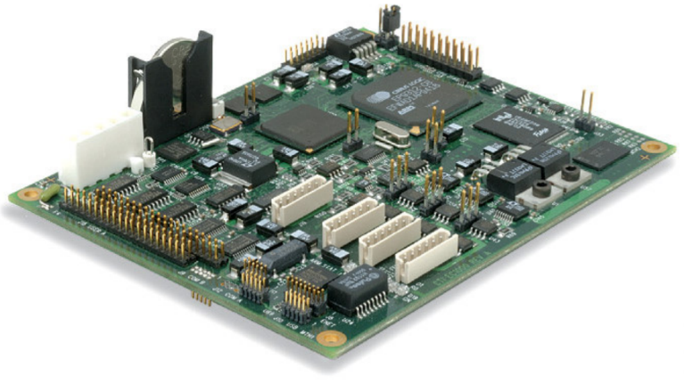
Sensors and Actuators
Communication with Actuators
Laser with Galvometers
EC 1000 controls Galvometers and Laser
Interface with LabVIEW
Communicates through XY2 100 protocol (updates at 100 kHz)
Quartz Lamps
Updated continuously (30 Hz or 60 Hz according to camera framerate)
Strip Heaters
Currently updated at 100 Hz, likely to be reduced to 10 Hz
EC 1000

Slide 8
Data Flow during Build
Flow Diagram for Standard Builds
Required Files
LabVIEW - Startup
CAD
1 Infill txt file per layer (USB drive or …>documents>builds)
STL file
Start build
(prompt asks for infill and outline txt file location)
Slicer (specifies layer thickness)
1 Outline txt file per layer (same folder)
Front panel control (Infill and Outline power)
Recorded for each layer (always the same though)
EC1000 prompt (input laser parameters)
Configuration File (.xml):
Sets temperatures for QL and Heaters
(…>trunk>LAMPS_Config_Files)
External Hard drive “Backup”

Slide 9
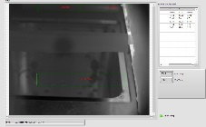
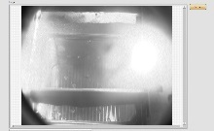
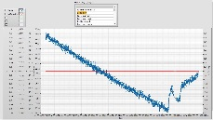
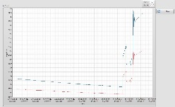
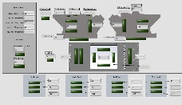
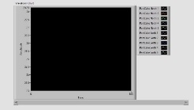
Data Flow during Build
Flow Diagram for Standard Builds
LabVIEW – Data Flow during Build
LabVIEW - Cooldown
LabVIEW
EC 1000
Visual Diagnostics
Laser & Galvos
Thermal Camera
Visual Camera
IR
Feedback with IR readings from powder bed
TC and DC of QL over time
Cooldown activated by front panel control button
.xlsx
ROI graph
Quartz Lamps
.tot
Input Cooldown config files (same folder as prev. config files
Config file
Strip Heaters
binary
Current TC readings
TC over time
Sample rate set in LV?
Thermocouples
.xlsx
External Hard drive “Backup”

Slide 10
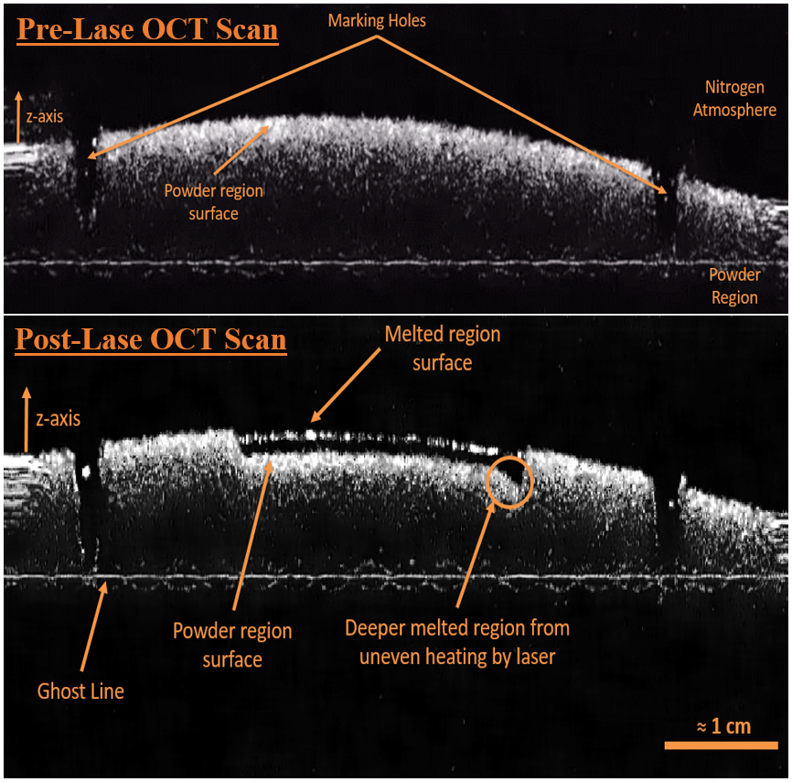
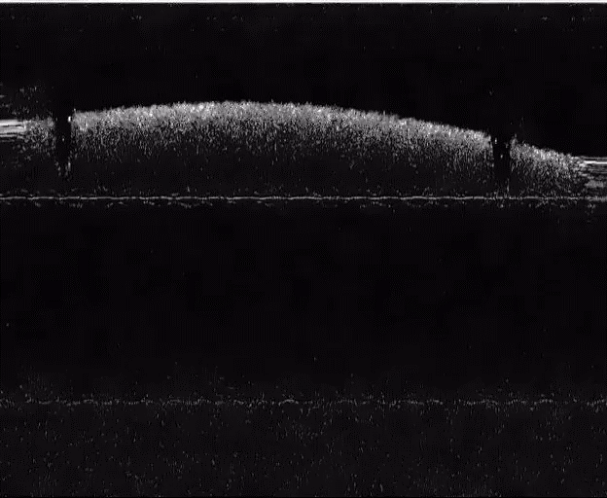
Data Flow during Build
OCT Data
OCT image on the right is B-Scan of the powder before and after the laser melted a line horizontally
Image shows a B-scan which consists of ca. 7000 A-scans (each A-scan is a column)
Single Scan Line Test Video
Each frame ≈ 0.03 seconds
Click on Video to play it.

Slide 11
Data Flow during Build
OCT Data I/O
Required data for OCT measurement
Set OCT parameters
set data collection time (how long)
Specify file storage location
OCT doesn’t require extra information during build, it will record for the time specified
As of now, OCT is not used in any control loop → build will process regardless of OCT measurement
What data is recorded during the build for either diagnostics or post build analysis?
Raw data is stored in a binary file in the storage location specified
OCT parameters are stored in a text file in the same storage location

